Slide 1
Total News: Putting the Public at the Center of the Civic Solar System
Rotary Club (July 30, 2026)
Dave Askins
The B Square Bulletin

Slide 2


Slide 3
Today’s Agenda
B Square: Then vs. Now
Total News: Future, Past, Present
Focus on Past: Documents, Timelines
What We Actually Lost
New Paradigm

Slide 4
B Square Bulletin: A local news outlet
Launched in July 2019
Mission: To give Bloomington residents an easy on-ramp to understanding the workings of local government, and to give them the information they need to contribute to Bloomington’s civic life.

Slide 5
B Square Bulletin: A local news outlet
Shut down end of 2024
Re-launched in March 2025
New Mission: To give Bloomington residents an easy on-ramp to understanding all aspects of the place where they live, and to give them the information they need to help Bloomington’s community thrive.

Slide 6
Total News: Future, Present, Past

Slide 7
Future
community calendar
links in news reporting

Slide 8
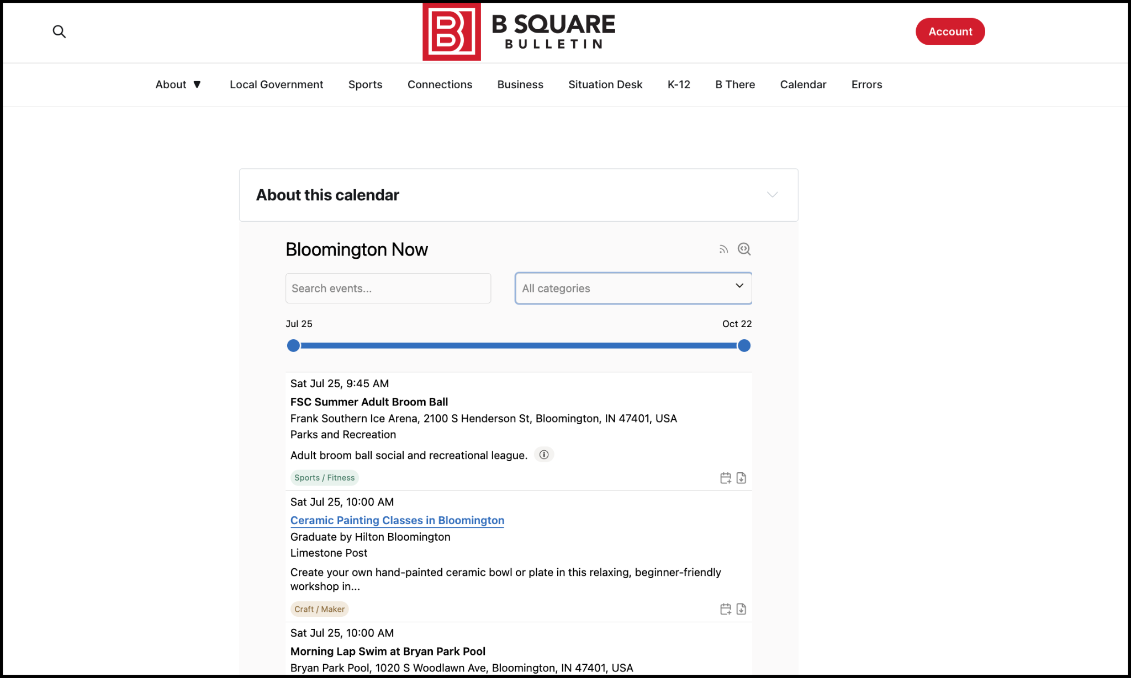

Slide 9
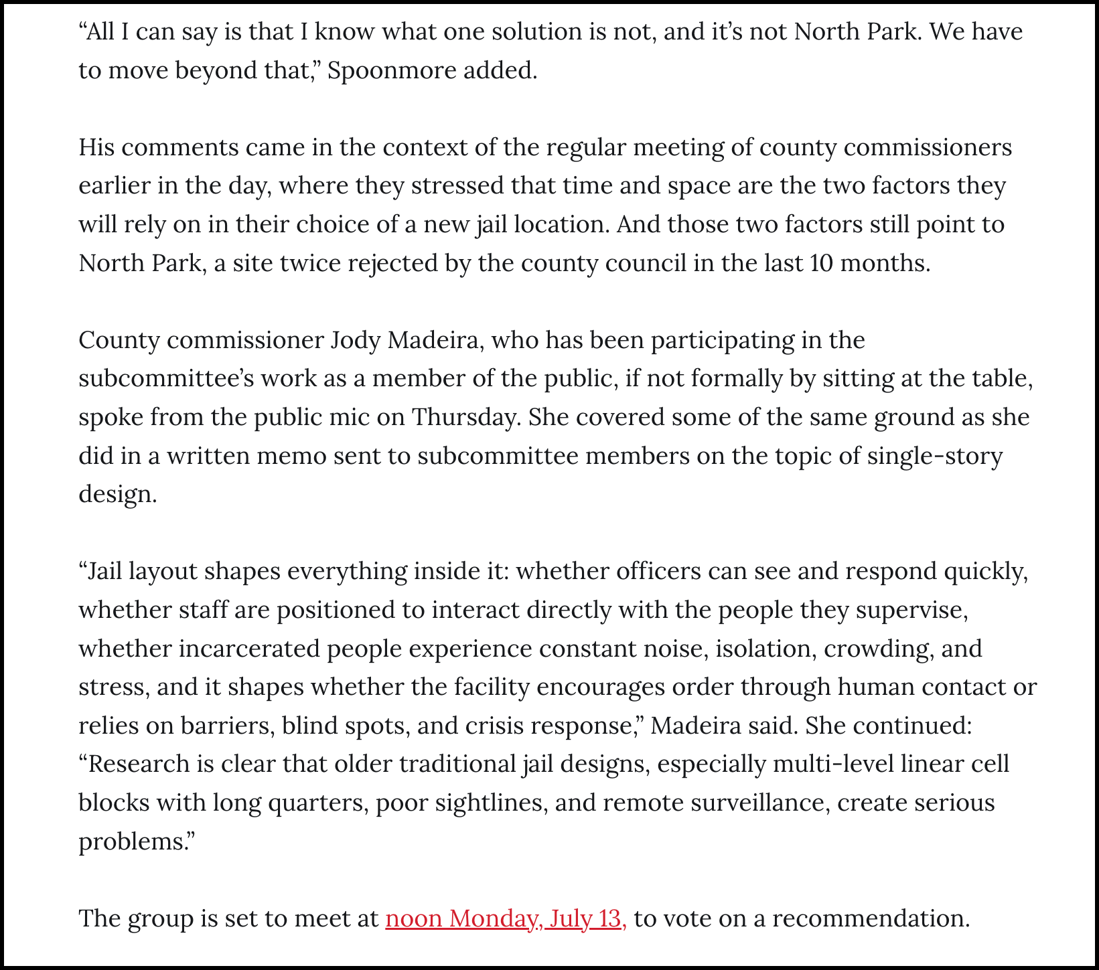

Slide 10
Present
website
individual articles by email
bi-weekly newsletter

Slide 11
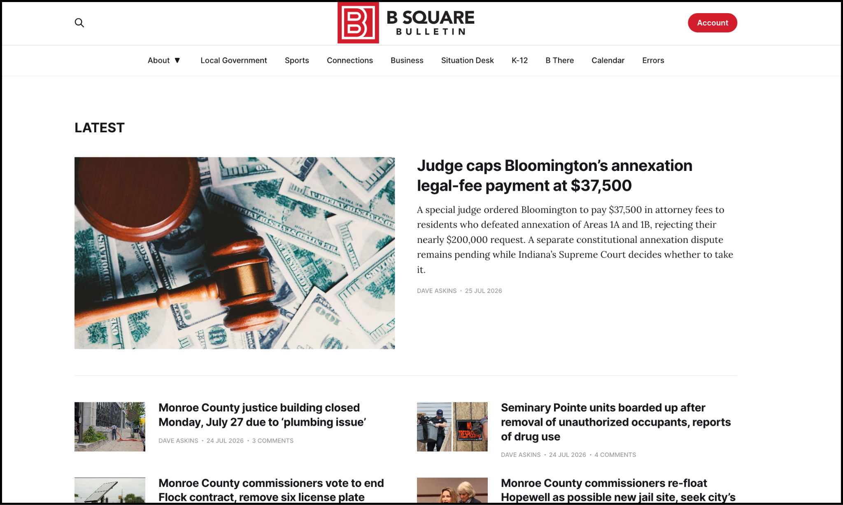

Slide 12
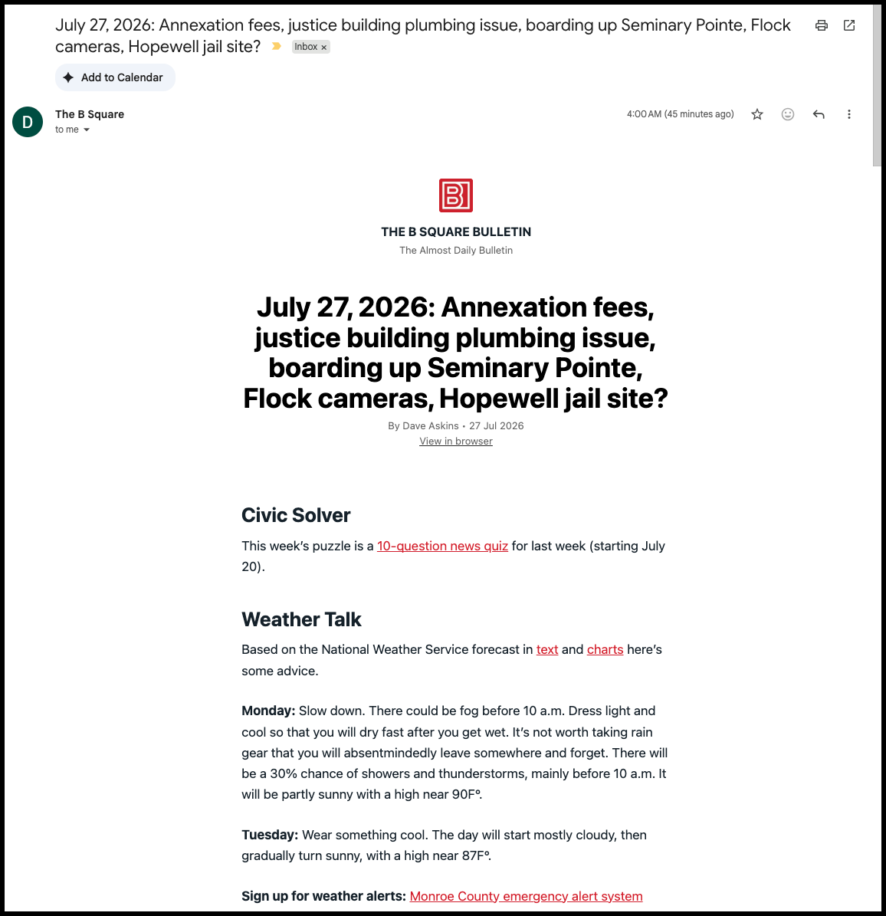

Slide 13
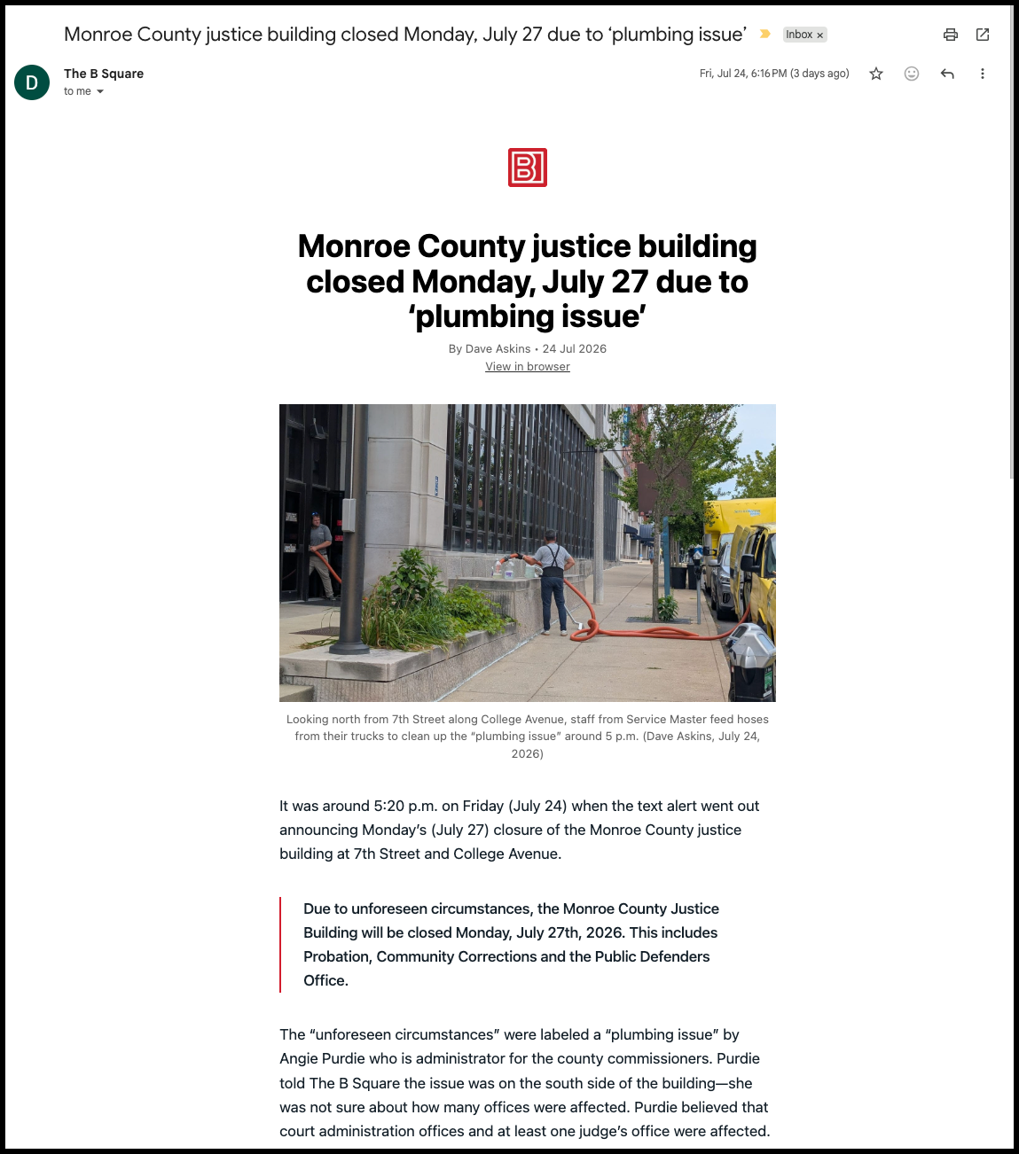

Slide 14
Past
file cabinet
clipping files

Slide 15
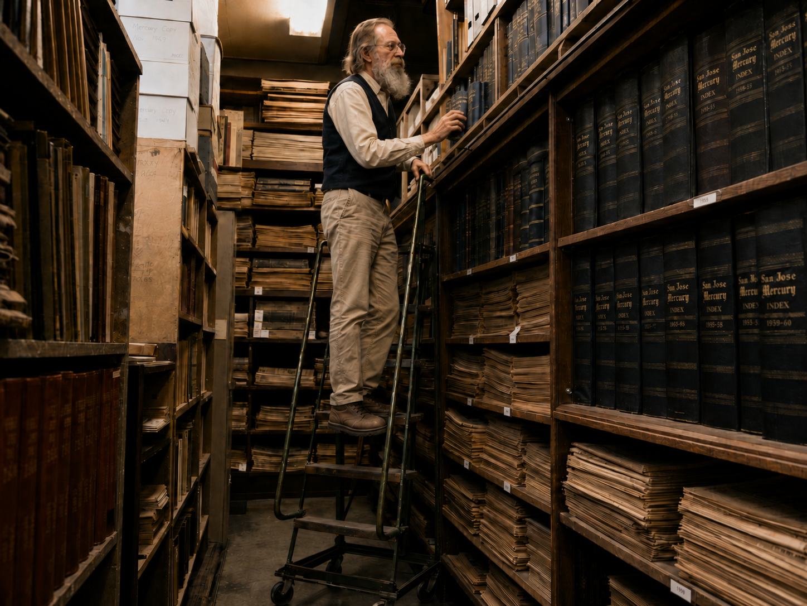
Image generated by ChatGPT

Slide 16
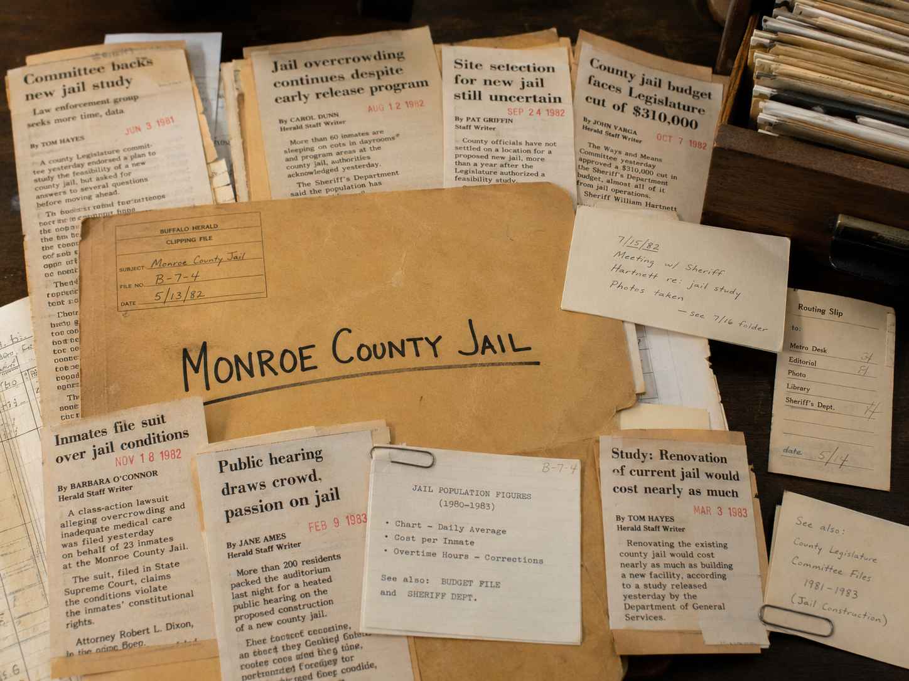
Image generated by ChatGPT

Slide 17
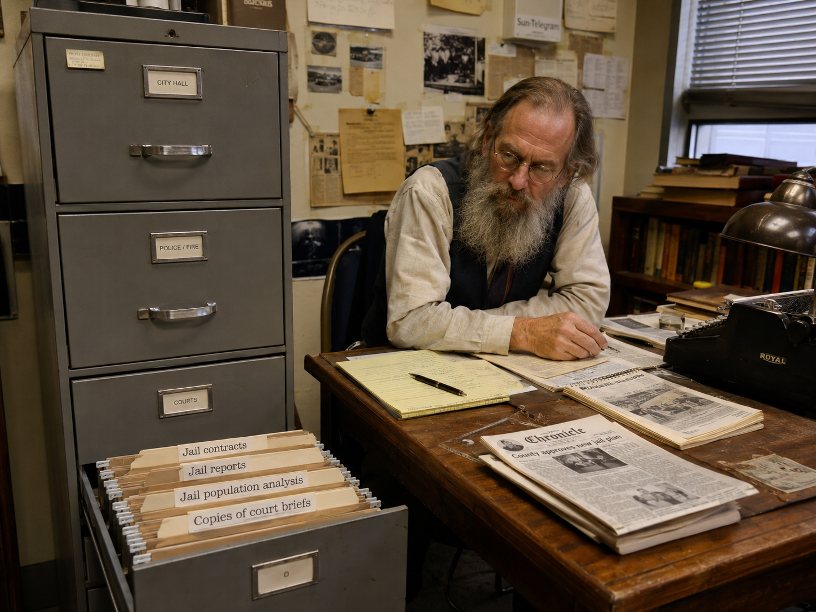
Image generated by ChatGPT

Slide 18
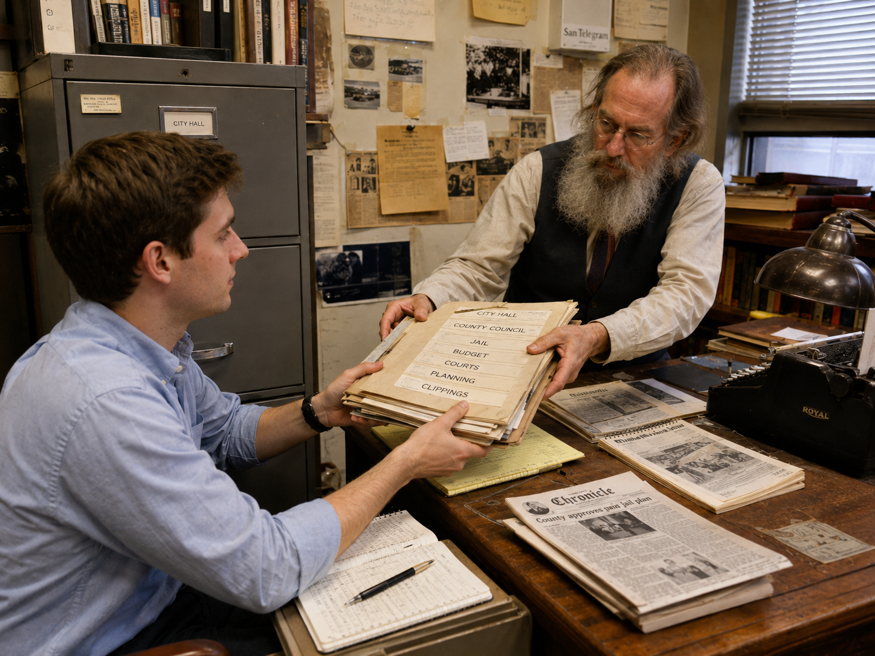
Image generated by ChatGPT

Slide 19
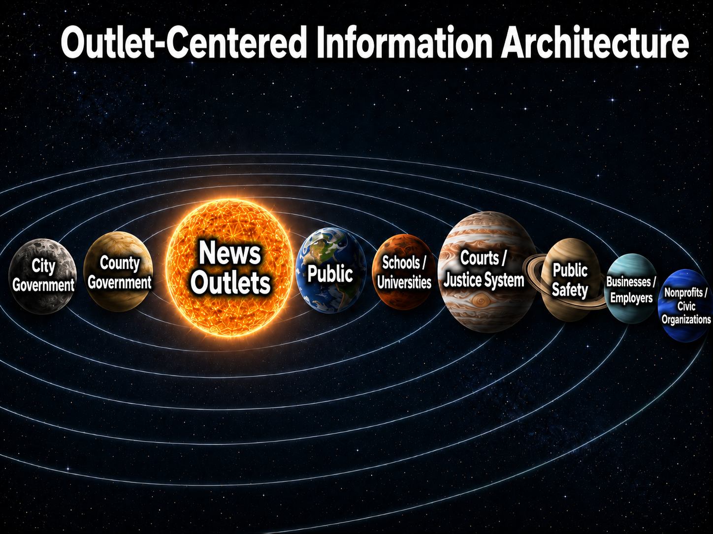
Image generated by ChatGPT

Slide 20
Past
Digital document repository (file cabinet)
Publicly available timeline collection (clipping files)

Slide 21
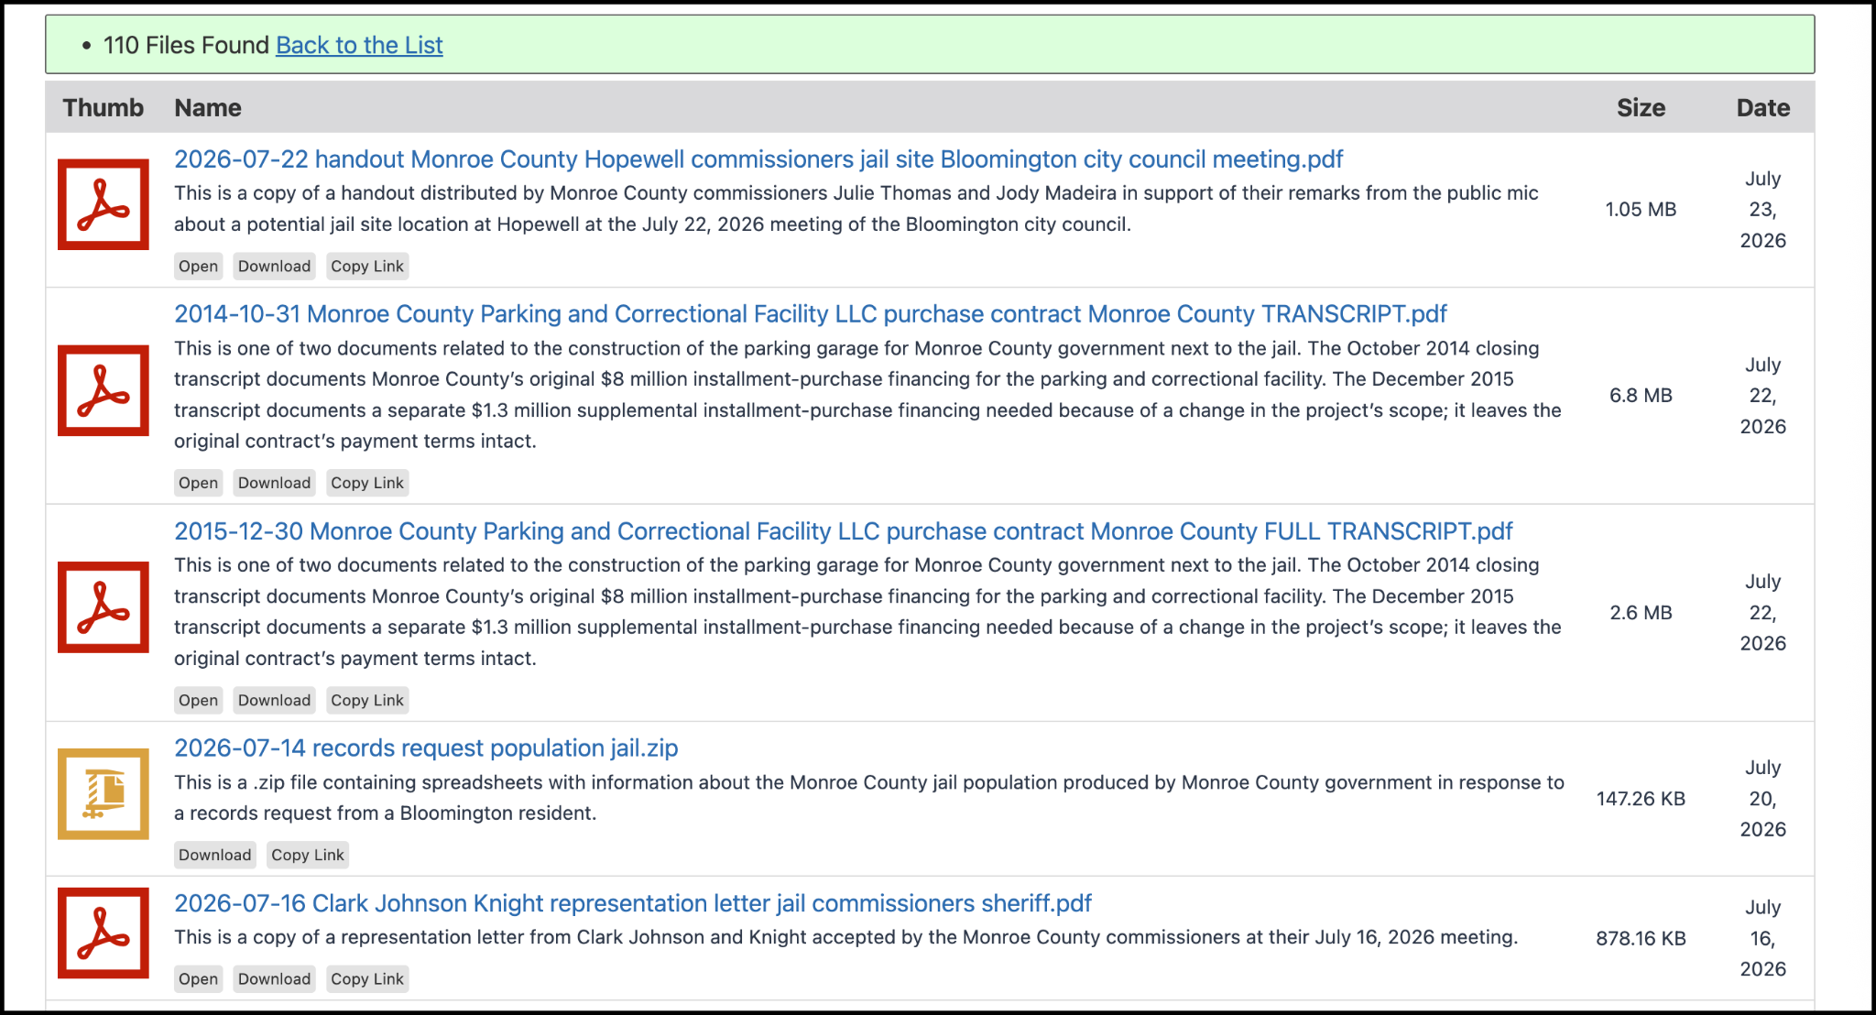

Slide 22
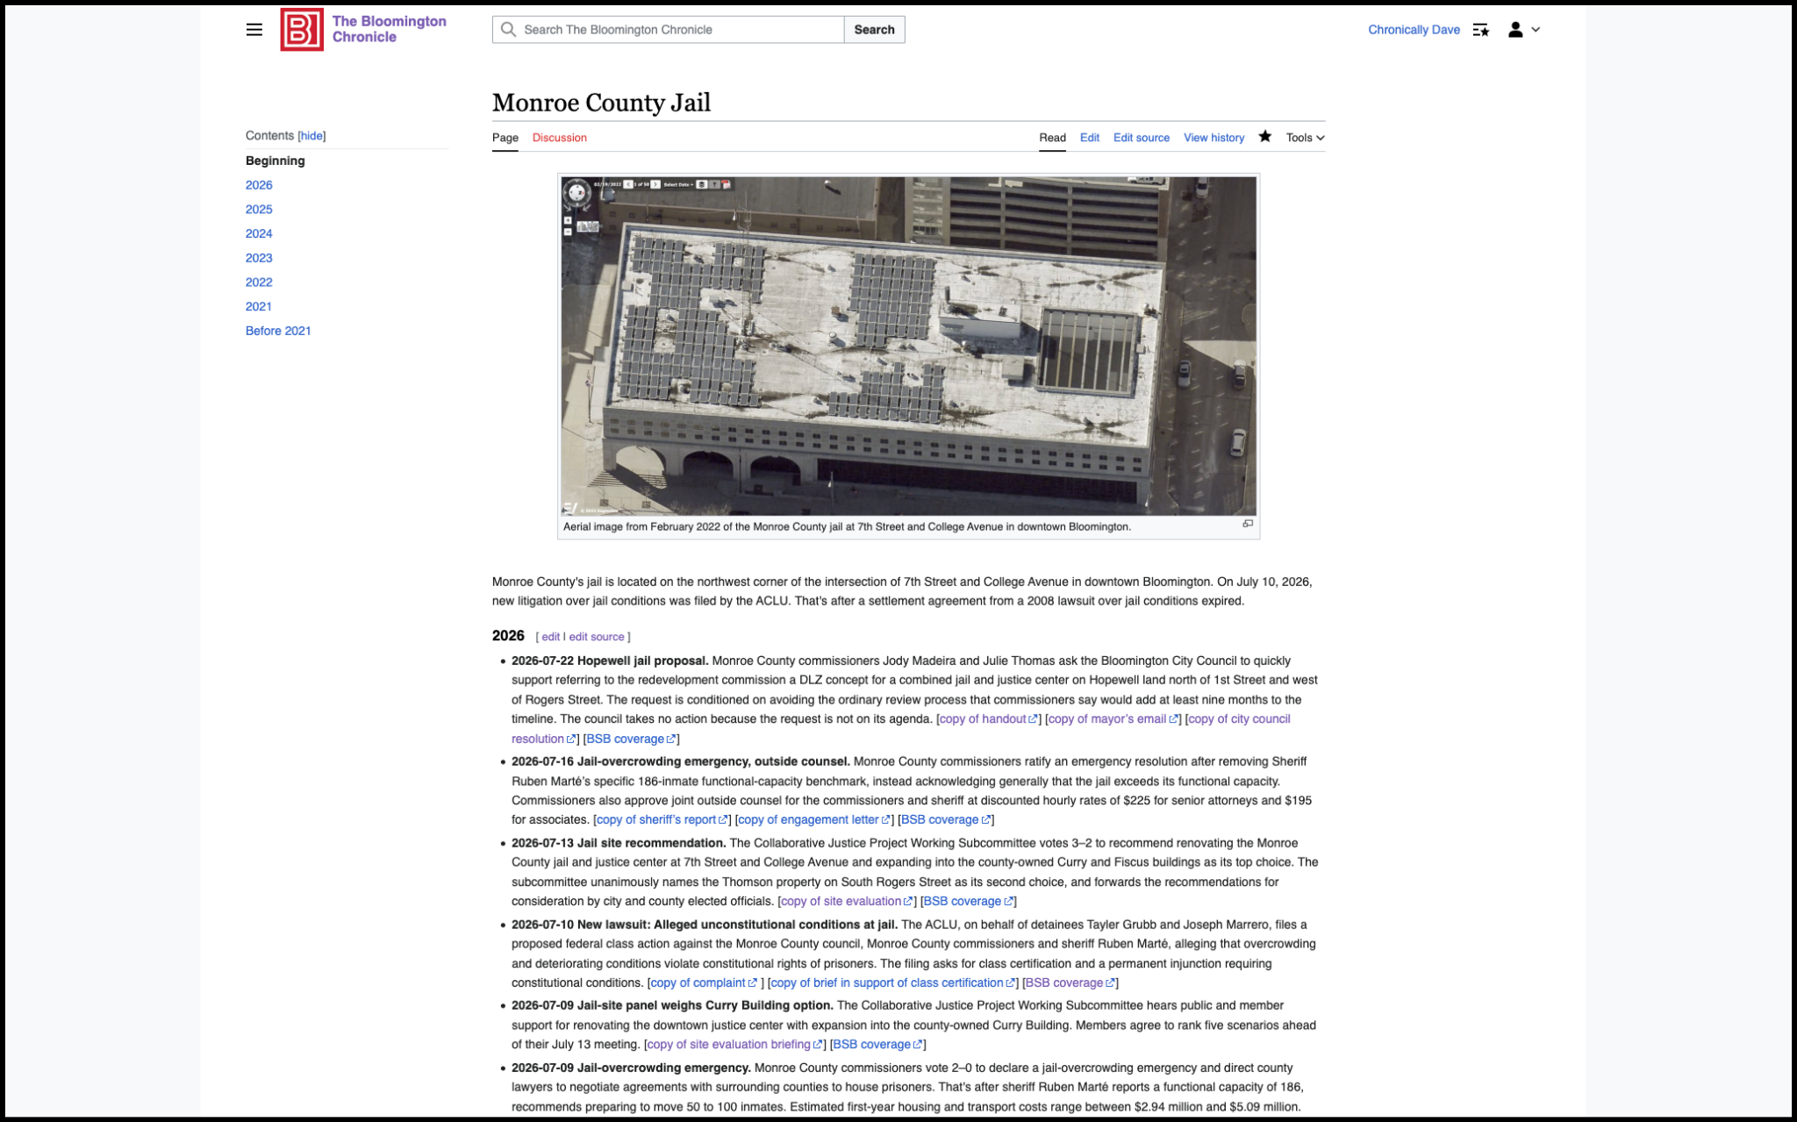

Slide 23
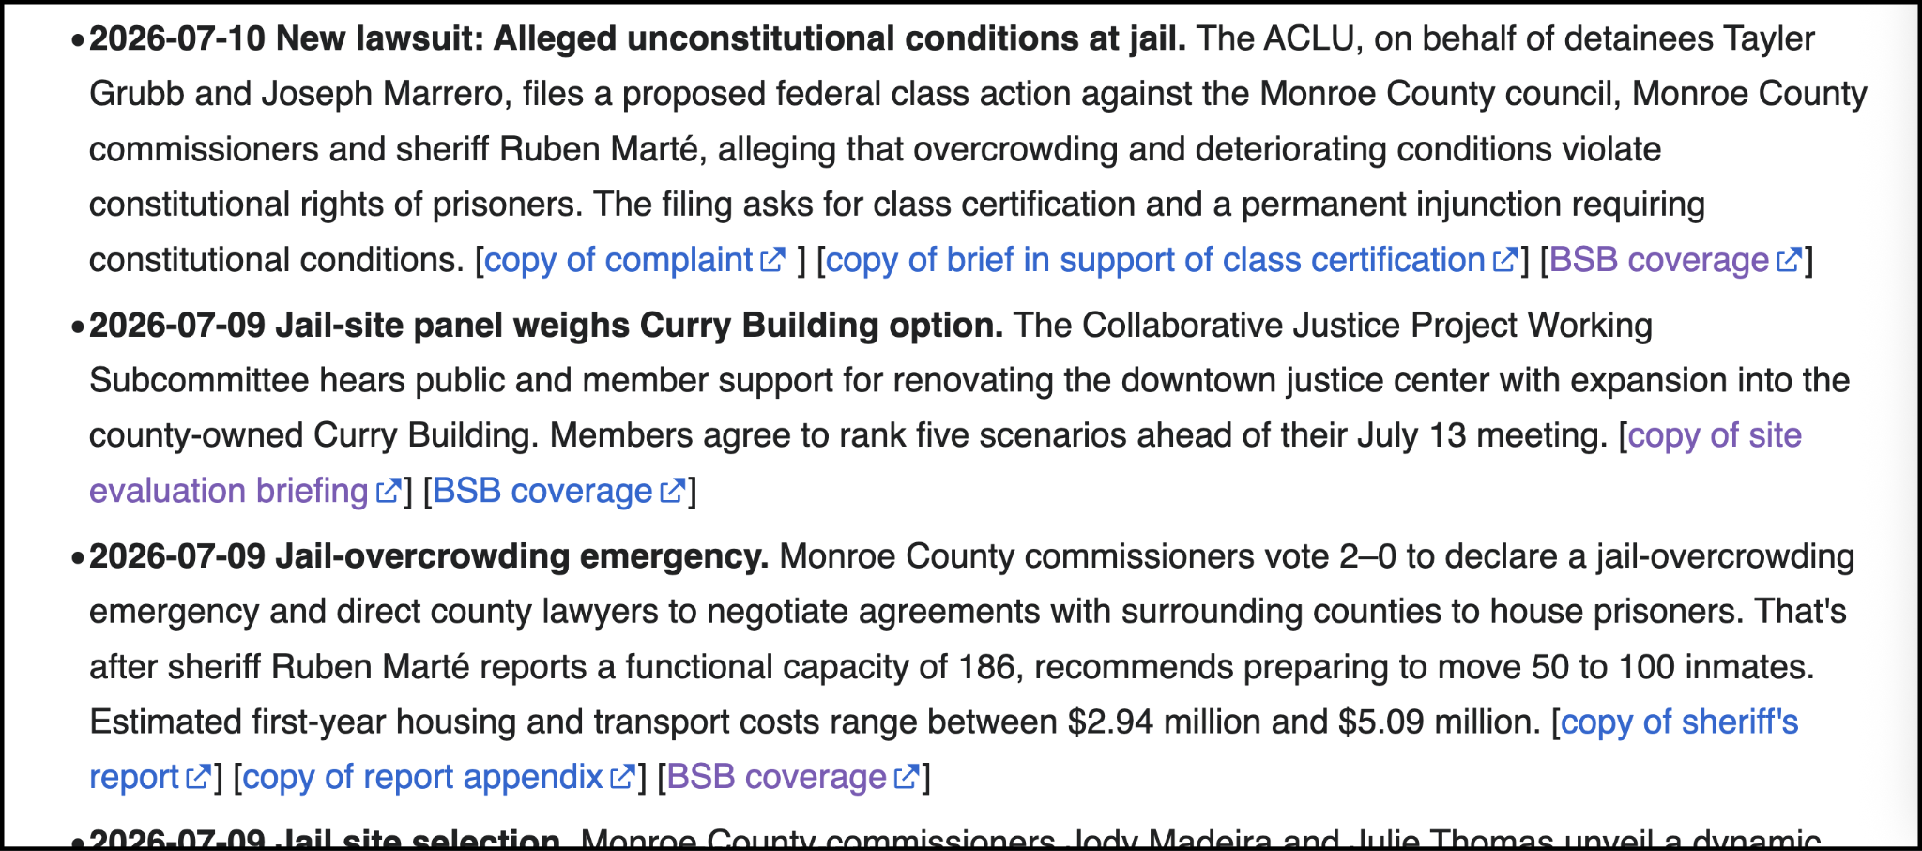

Slide 24
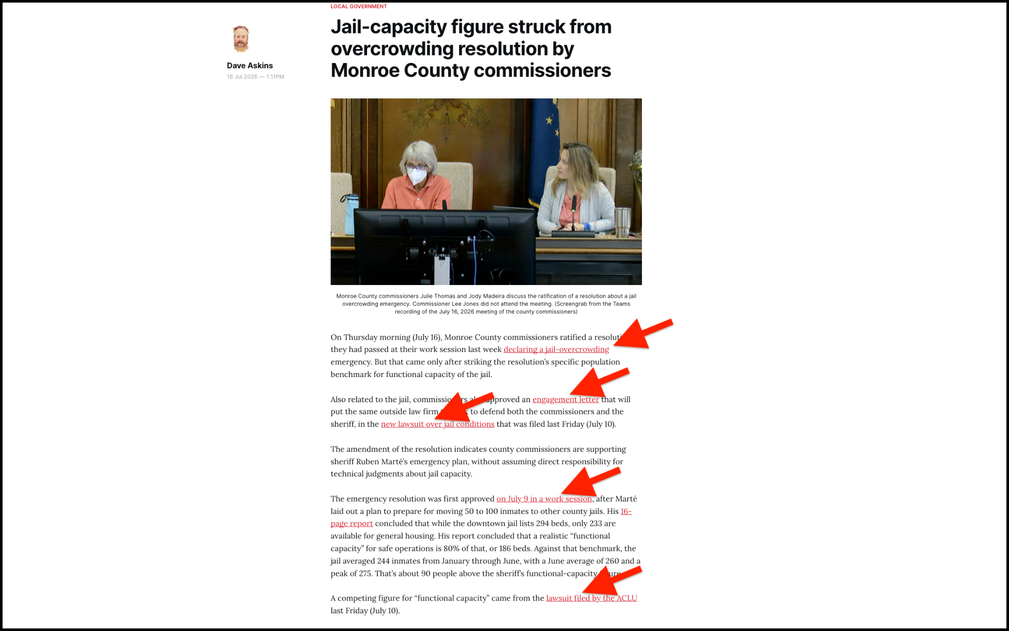

Slide 25
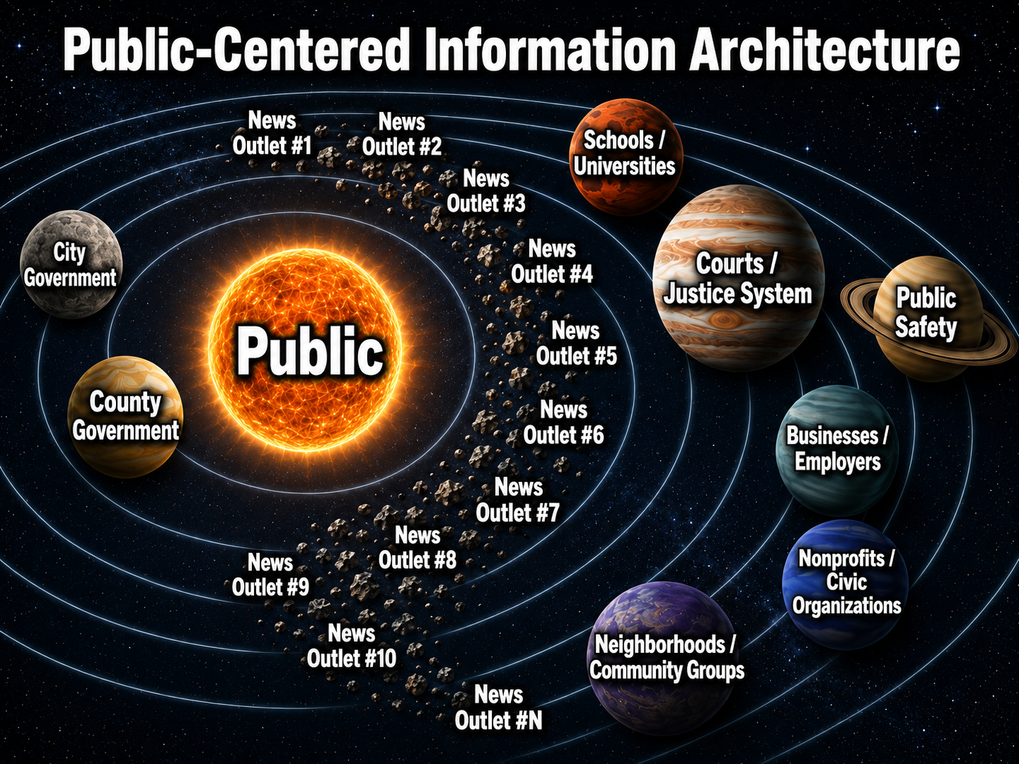
Image generated by ChatGPT

Slide 26
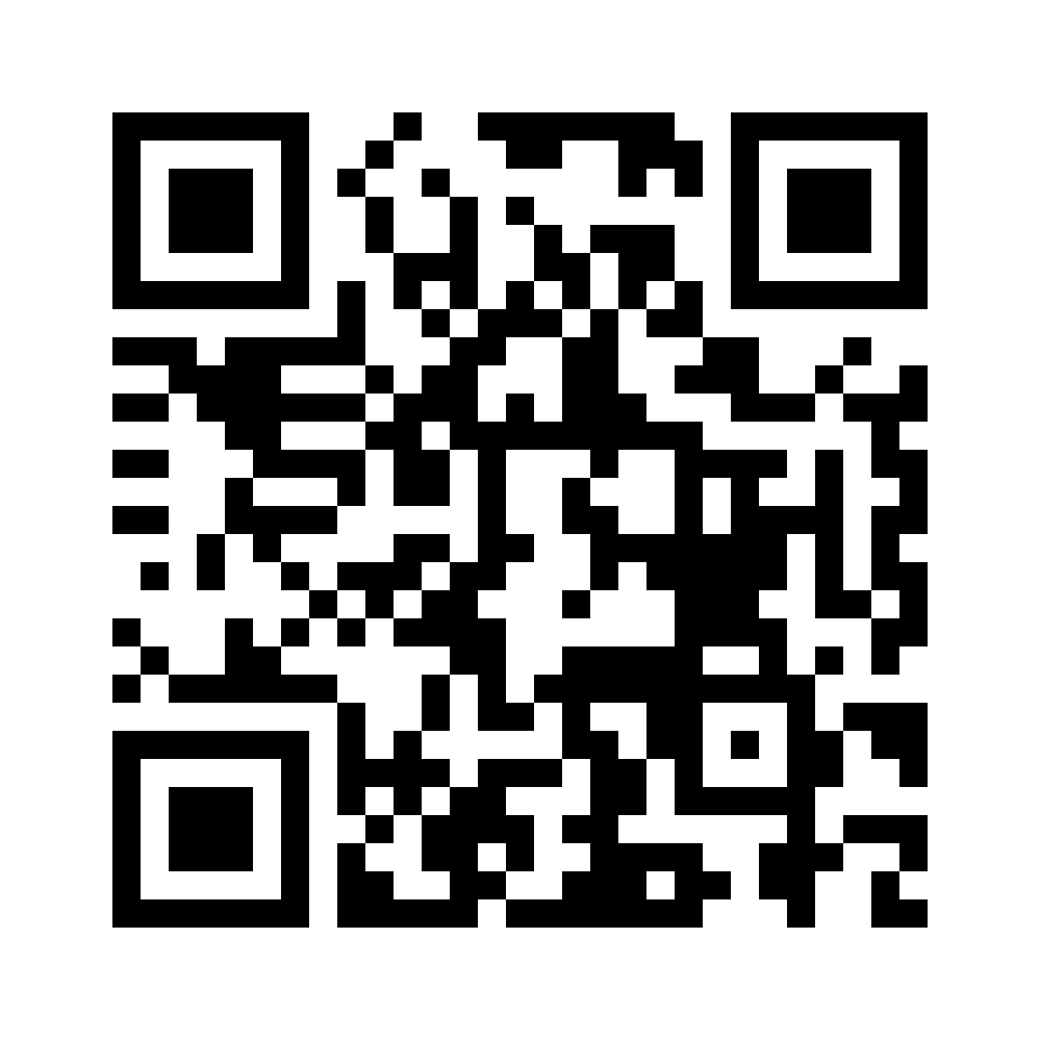
Sign up for the
“Almost Daily Bulletin” Newsletter

Slide 27
Questions

